Slide 1



Blazor .Net in your Browser running on Web Assembly!
Xavier Solau
A .Net fan
On Github: xaviersolau

Slide 2
The agenda…
About .Net
The Blazor project
Design and flexibility
Availability and Release
Demo

Slide 3
About .Net

Slide 4
About .Net
.Net Cross Platform
.Net implementation | Application types | OS
.Net Core | Web site; Server; Console | Windows; Linux; MacOS
.Net Framework | Web site; Server; Service; Desktop | Windows
Mono | Mobile (with Xamarin) | iOS; Android

Slide 5


About .Net
Want to know more?
Open source
Active community
Languages: C#; F#
A single API: .Net Standard
ASP.Net Core, Entity Framework Core, ML.Net….
Many tools:
Visual Studio
.Net CLI available for other editor integration (Visual Studio Code…)

Slide 6
?
So I can use the .Net stack on all platforms!....
But not on my browser web apps ???

Slide 7
The Blazor project

Slide 8

The Blazor project
Build client web apps with .Net
Write code in C# or F#
Full-stack .NET
WebAssembly (no plugin; no transpilation)
All browsers (asm.js fallback)
Simple and productive (stable and reliable tools)
Leverage the existing .NET ecosystem
Open-source
First beta in 2018!
Experimental? Not any more!
It’s in official preview!

Slide 9
The Blazor project
Is that a new Silverlight?... No!!!
Rely on open web standards (HTML, CSS…)
JS interoperability (Reuse of existing JavaScript)
Use DOM and browser API
HTML generation using:
Razor
Code C#
Browser + Razor = Blazor!
Notes:
Components
Layouts
Dependency injection
Routing
JavaScript interop
Debugging

Slide 10
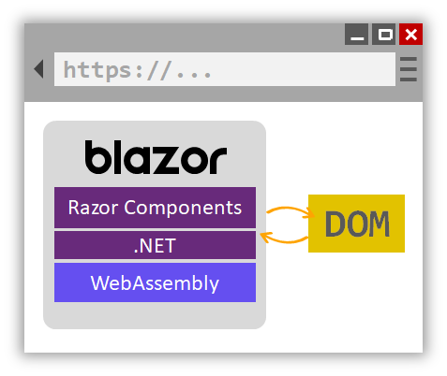
The Blazor project
So how does it work?
Run in browser sandbox (same as JS code)
Use Mono for the .NET runtime
Browser-side Blazor
Notes:
Components
Layouts
Dependency injection
Routing
JavaScript interop
Debugging

Slide 11

The Blazor project
Why Mono?
Open source supported by Microsoft
Used with Xamarin on iOS, Android, macOS…
Available on WebAssembly
The alternatives:
.Net Core: server application oriented
CoreRT (.NET AoT compiler): is “work-in-progress”

Slide 12
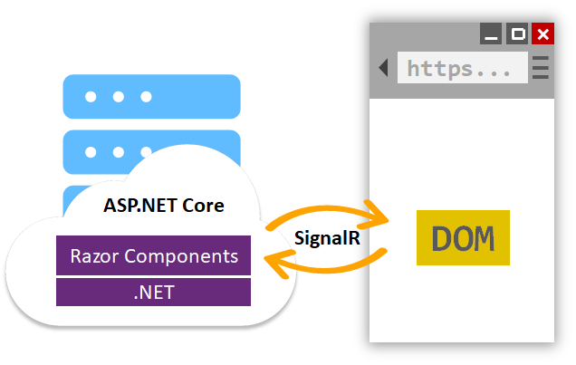
The Blazor project
Not only running on client?
Run on the web server
Use.NET Core runtime
Server-side Blazor
Notes:
Components
Layouts
Dependency injection
Routing
JavaScript interop
Debugging

Slide 13
The Blazor project
Is it the same app?
Regardless of the hosting model, the app and component models are the same.
Notes:
Components
Layouts
Dependency injection
Routing
JavaScript interop
Debugging

Slide 14

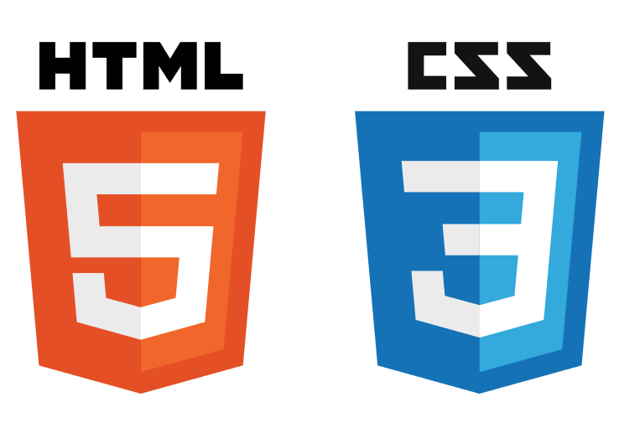

The Blazor project
A smart use of existing technologies

Slide 15
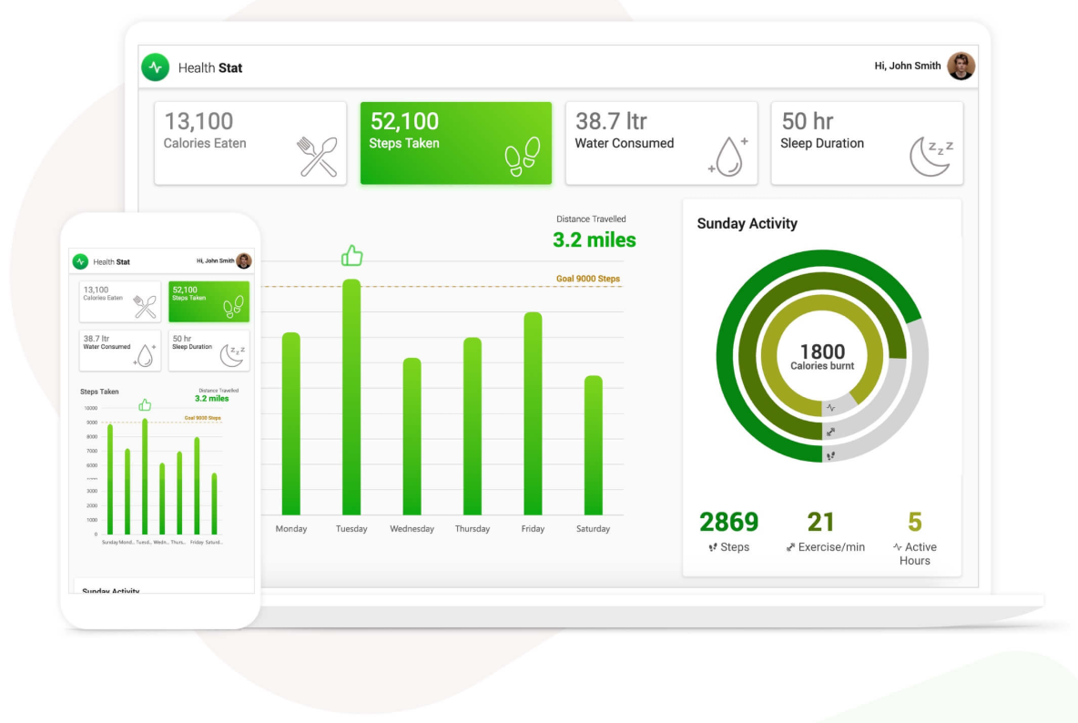
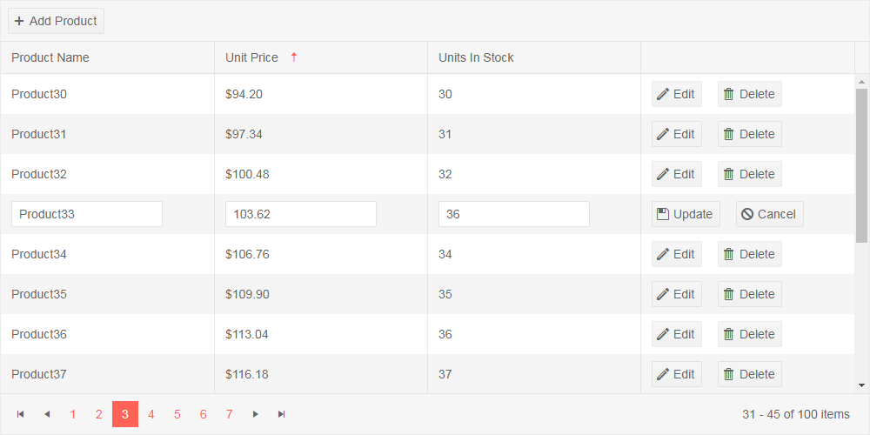
The Blazor project
.NET Blazor ecosystem ?
Many components from:
Syncfusion
Telerik
DevExpress
Community
ChartJs.Blazor
MatBlazor
…
223 packages on Nuget.org
~150 000 Blazor downloads

Slide 16
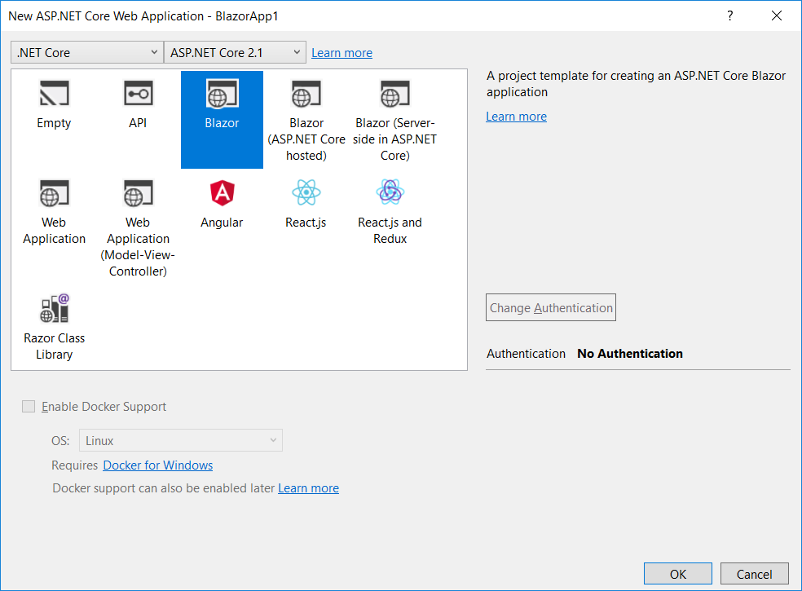
The Blazor project
Get started with Blazor…
Latest .NET Core 3.0 Preview SDK
Blazor templates
With Visual Studio:
Visual Studio “preview”
Blazor extension from VS Marketplace
Select ASP.NET Core Web Application.
With .Net Core CLI
dotnet new -i Microsoft.AspNetCore.Blazor.Templates
dotnet new blazor -o WebApplication1
dotnet new blazorserverside -o WebApplication1

Slide 17
Design and flexibility

Slide 18
Design and flexibility
Overview
CS and Razor Files
Browser Sandbox
Mono.js
Blazor.webassembly.js
.Net compiler
Application dlls
.Net Framework dlls
Mono.wasm

Slide 19
Design and flexibility
DOM Interactions Browser-Side
Browser Sandbox
Mono
JavaScript
DOM
UI Tree
DOM update
Events processing
UI tree update and delta computation
Transform UI Tree element to DOM
Forward UI events
Events
Display
Send user events
Events
UI Delta
DOM update

Slide 20
Design and flexibility
DOM Interactions Server-Side
Server
SignalR
Browser Sandbox
CoreCLR
JavaScript
DOM
UI Tree
DOM update
Events processing
UI tree update and delta computation
Transform UI Tree element to DOM
Forward UI events
Events
Display
Send user events
Events
UI Delta
DOM update

Slide 21
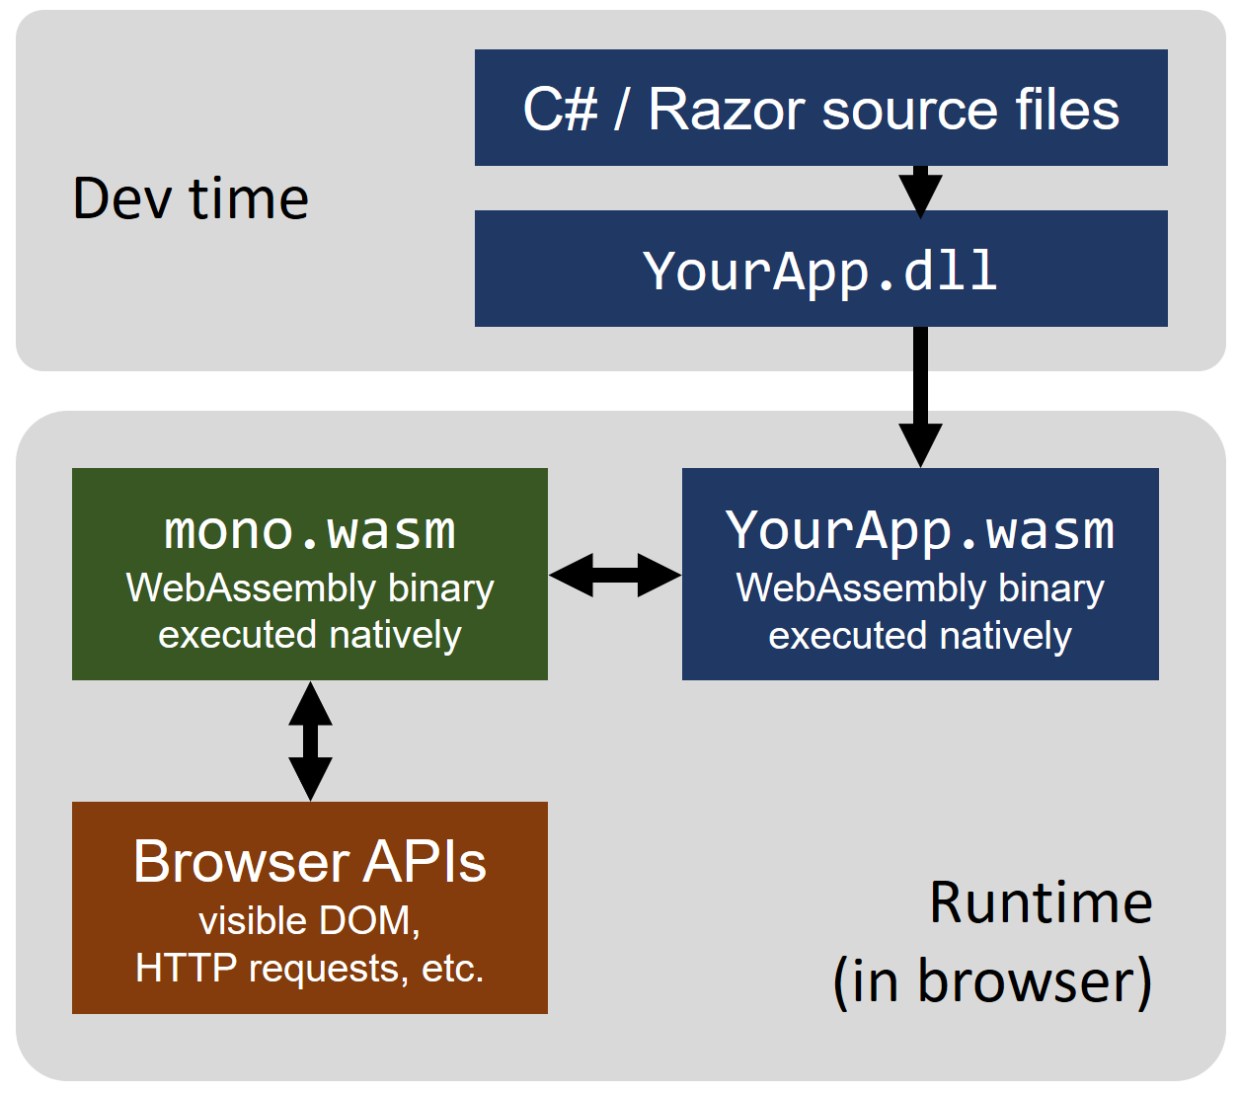
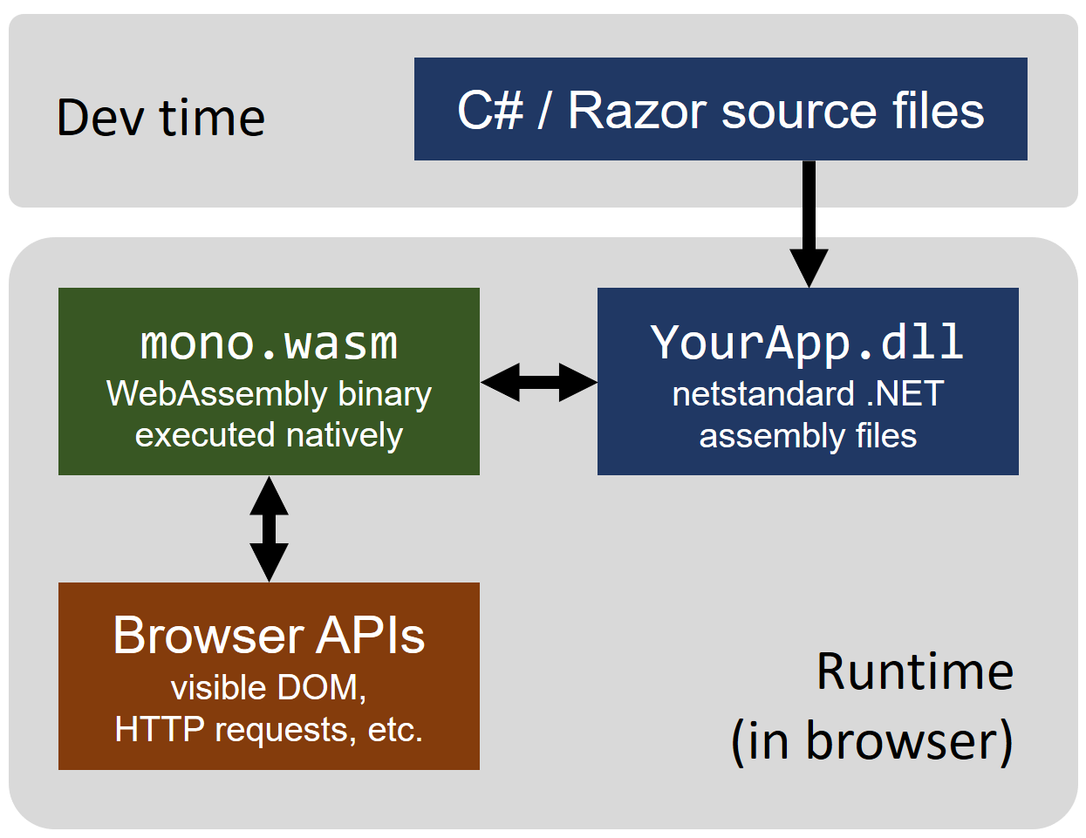
Design and flexibility
Performances?!
Tomorrow:
Ahead-of-time (AOT) compiled mode
DOM Access from Web Assembly
Today:
Interpreted mode
Linker (DLL trimmer/tree shaker)

Slide 22
Design and flexibility
The pros and cons?
 | Blazor | Browser-side | Server-side
 | Single Component / application model Debugging experience Single Stack Flexibility Nuget packages JS Interop Tooling (VS2019, VSCode) | Mono Performances on WASM Off line | Small bundle (~400Kb) .Net Core performances
 | DOM access through JS cost? | Bundle size Cache Trimmer | Must be on line How about scalability?

Slide 23
Availability and Release

Slide 24

Availability and Release
When can I use it?
Browser-side Blazor
Server-side Blazor
3.0
Now in official preview
Scheduled for September 2019

Slide 25
Demo

Slide 26
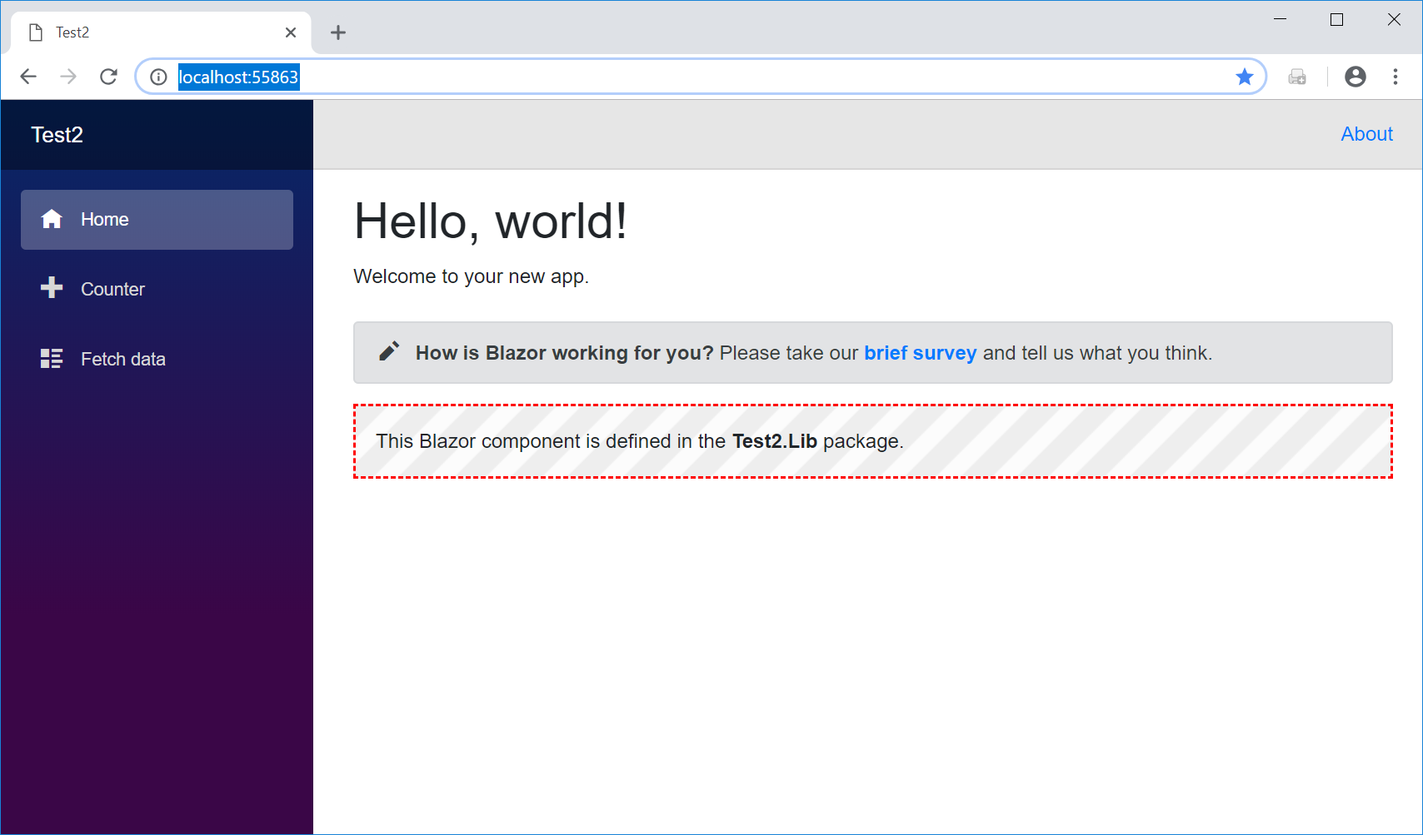
Demo
Demo agenda:
Projects and CSHTML
Components
Client-side
Server-side
Bonus!!

Slide 27
Thanks! Any questions?

Slide 28
Démo
Nouveaux projets en ligne de commande…
Nouveau client Blazor
dotnet new blazor
Nouveau client Blazor hosté dans un serveur NetCore:
dotnet new blazorhosted
Nouvelle librairie:
dotnet new blazorlib
Nouveau serveur Blazor:
dotnet new blazorserverside

Slide 29
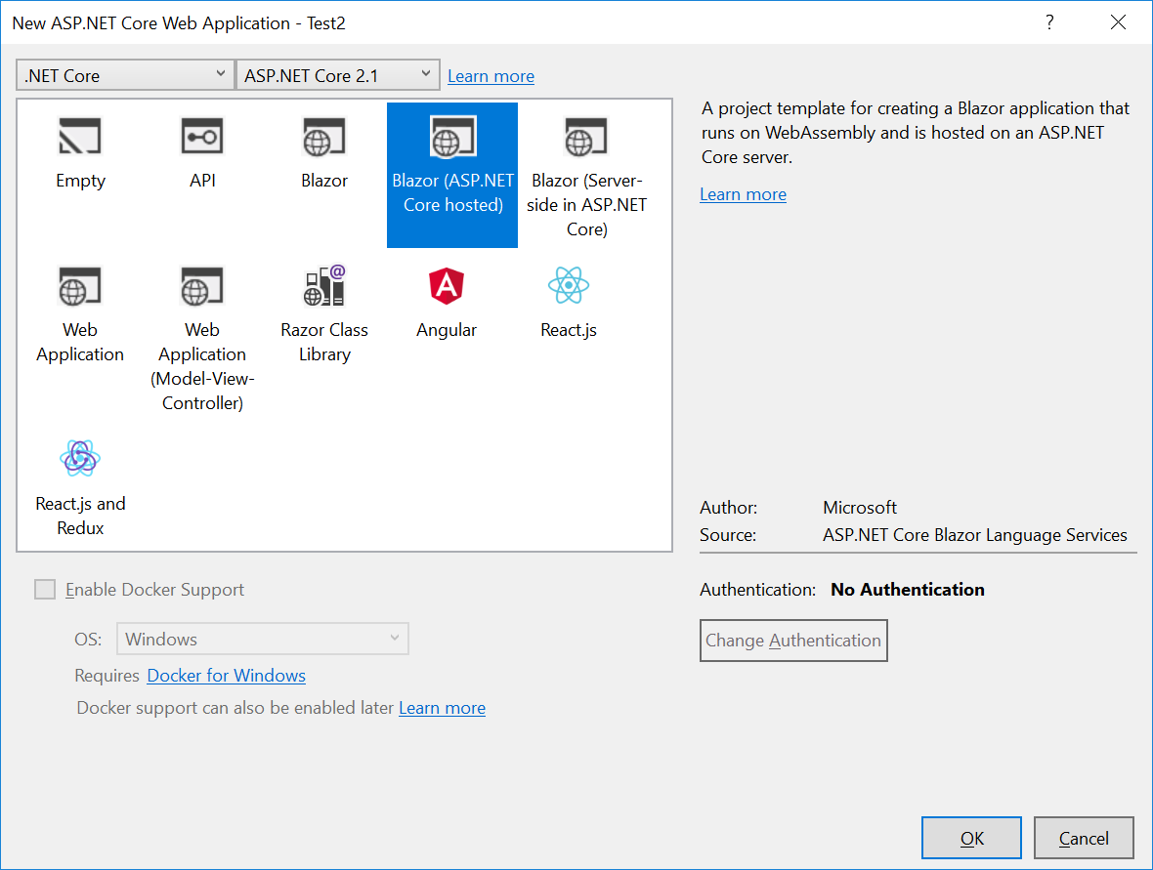
Démo
Nouveaux projets dans Visual Studio…

Slide 30
Démo
Pour debugger…
Pour debugger le client:
Shift+Alt+D on Windows
Shift+Cmd+D on macOS
Utiliser Chrome avec l’option « remote debugging »:
"%programfiles(x86)%\Google\Chrome\Application\chrome.exe" --remote-debugging-port=9222 http://localhost:55863/

Slide 31
Démo
Pour utiliser une librairie…
Créer une librairie
dotnet new blazorlib
Ajouter dans la solution
Ajouter les noms de vos composants dans _ViewImports.cshtml:
@addTagHelper *, Test2.Lib
Utiliser votre composant:
<Component1/>
Et vous pouvez partager votre composant très simplement avec Nuget!!!

Slide 32
Démo
Pour passer en server-side…
Modifier le startup.cs du server:
Dans void ConfigureServices(IServiceCollection services)
services.AddServerSideBlazor<Client.Startup>();
Dans void Configure(IApplicationBuilder app, IHostingEnvironment env)
app.UseServerSideBlazor<Client.Startup>();
A la place de:
app.UseBlazor<Client.Startup>();
Modifier le index.html du client:
Remplacer:
<script src="_framework/blazor.webassembly.js"></script>
Par:
<script src="_framework/blazor.server.js"></script>

